Slide 1
INTRODUCTION TO COMPUTING
Course Code: CCINCOM/L
Queues
Department of Computer Science
College of Computing and Information Technologies (CCIT)
National University
Joseph Marvin R. Imperial
DATA STRUCTURES AND ALGORITHMS
NU College of Computing and Information Technologies
Course Code: CCDATRCL

Slide 2
Abstracting data structures
Stacks, queues, and priority queues are more abstract entities than arrays, list and other data storage structures.
They’re defined primarily by their interface: the permissible operations that can be carried out on them.
The underlying mechanism used to implement them is typically not visible to their user.
Joseph Marvin R. Imperial
DATA STRUCTURES AND ALGORITHMS
NU College of Computing and Information Technologies
Course Code: CCDATRCL

Slide 3
Queues
Queue is an abstract data type or a linear data structure in which the first element is inserted from one end called the rear (also called tail), and the removal of existing element takes place from the other end called as front (also called head).
The queue has two principal operations:
enqueue - add an element into queue via the tail
dequeue - removal of an element from queue via the head
This makes queue as FIFO (First in First Out) data structure, which means that element inserted first will be removed first.
Joseph Marvin R. Imperial
DATA STRUCTURES AND ALGORITHMS
NU College of Computing and Information Technologies
Course Code: CCDATRCL

Slide 4
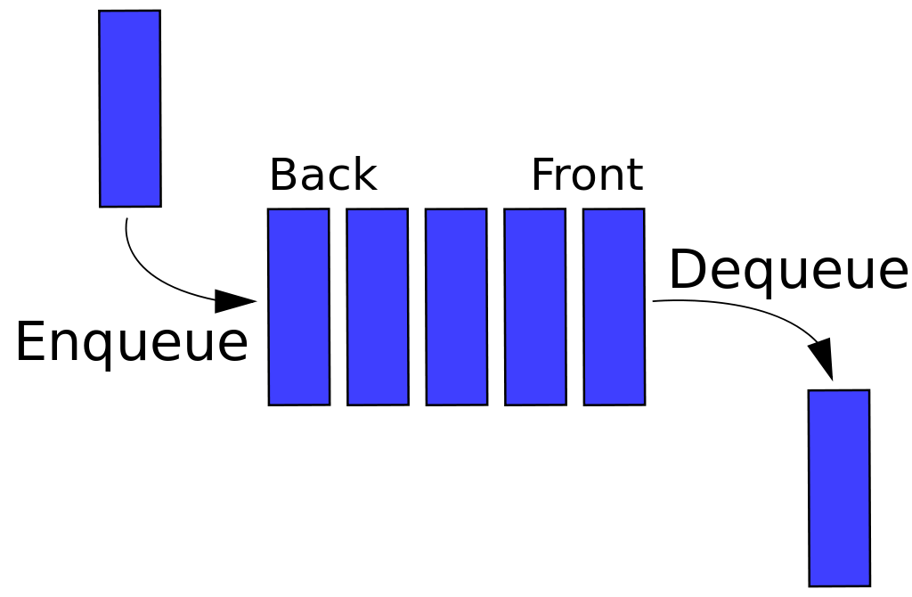
Queues
Joseph Marvin R. Imperial
DATA STRUCTURES AND ALGORITHMS
NU College of Computing and Information Technologies
Course Code: CCDATRCL

Slide 5

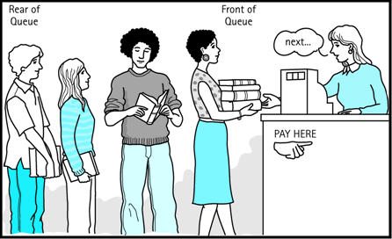
Queues
Joseph Marvin R. Imperial
DATA STRUCTURES AND ALGORITHMS
NU College of Computing and Information Technologies
Course Code: CCDATRCL

Slide 6
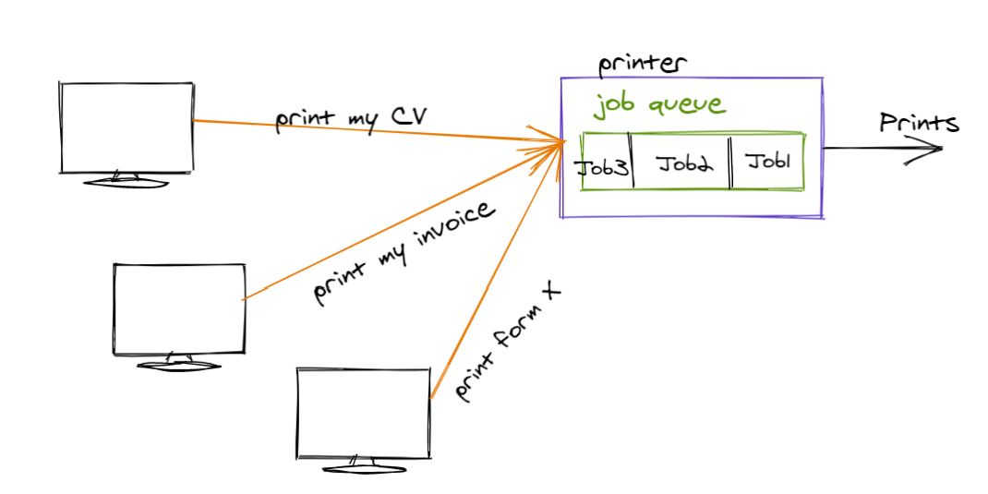
Queues
Joseph Marvin R. Imperial
DATA STRUCTURES AND ALGORITHMS
NU College of Computing and Information Technologies
Course Code: CCDATRCL

Slide 7
Notes
Queues usually don’t have specific capacity. However, if you are to use an array, you will need to declare a MAXSIZE. A bounded queue is a queue limited to a fixed number of items.
Overflow results from trying to add an element onto a full queue and underflow happens when trying to remove an element from an empty queue.
A queue can be implemented using dynamic arrays, double-ended linked lists, doubly linked lists.
Joseph Marvin R. Imperial
DATA STRUCTURES AND ALGORITHMS
NU College of Computing and Information Technologies
Course Code: CCDATRCL

Slide 8
Queue operations
enqueue() − add (store) an item to the queue.
dequeue() − remove (access) an item from the queue.
peek() − Gets the element at the front of the queue without removing it.
isfull() − Checks if the queue is full, if queue is implemented using static arrays
isempty() − Checks if the queue is empty.
display() – display the contents of the queue
Joseph Marvin R. Imperial
DATA STRUCTURES AND ALGORITHMS
NU College of Computing and Information Technologies
Course Code: CCDATRCL

Slide 9
Queue implementation conditions
two pointers FRONT and REAR
The FRONT pointer tracks the first element of the queue
The REAR pointer tracks the last elements of the queue
initially, set value of FRONT and REAR to -1
Joseph Marvin R. Imperial
DATA STRUCTURES AND ALGORITHMS
NU College of Computing and Information Technologies
Course Code: CCDATRCL

Slide 10
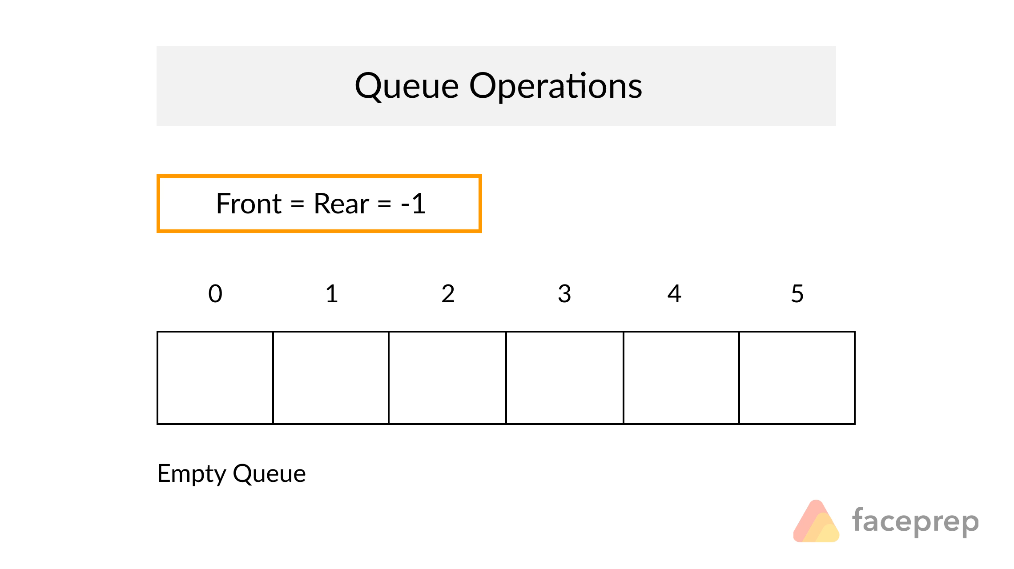
Joseph Marvin R. Imperial
DATA STRUCTURES AND ALGORITHMS
NU College of Computing and Information Technologies
Course Code: CCDATRCL

Slide 11
Enqueue (insertion)
Joseph Marvin R. Imperial
DATA STRUCTURES AND ALGORITHMS
NU College of Computing and Information Technologies
Course Code: CCDATRCL

Slide 12
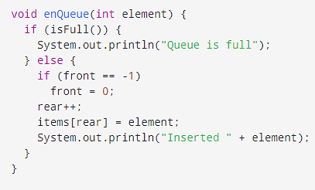
Enqueue (insertion)
Joseph Marvin R. Imperial
DATA STRUCTURES AND ALGORITHMS
NU College of Computing and Information Technologies
Course Code: CCDATRCL

Slide 13
Dequeue (deletion)
Joseph Marvin R. Imperial
DATA STRUCTURES AND ALGORITHMS
NU College of Computing and Information Technologies
Course Code: CCDATRCL

Slide 14
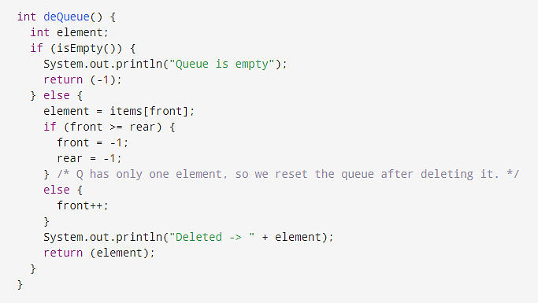
Dequeue (deletion)
Joseph Marvin R. Imperial
DATA STRUCTURES AND ALGORITHMS
NU College of Computing and Information Technologies
Course Code: CCDATRCL

Slide 15
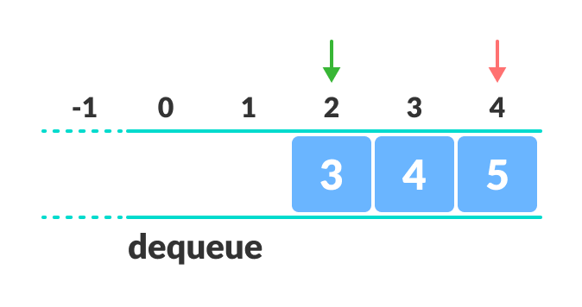
Limitations
From the scenario above, the indexes 0 and 1 can only be used after the queue is reset when all the elements have been dequeued.
Joseph Marvin R. Imperial
DATA STRUCTURES AND ALGORITHMS
NU College of Computing and Information Technologies
Course Code: CCDATRCL

Slide 16
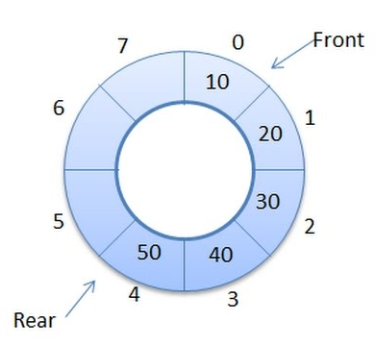
Circular Queues / Buffer
Circular queue is a data structure that uses a single, fixed-size buffer as if it were connected end-to-end.
It works by the process of circular increment. When we try to increment the pointer and we reach the end of the queue, we start from the beginning of the queue.
Joseph Marvin R. Imperial
DATA STRUCTURES AND ALGORITHMS
NU College of Computing and Information Technologies
Course Code: CCDATRCL

Slide 17
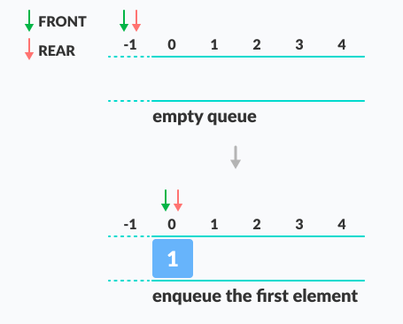
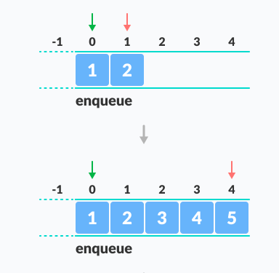
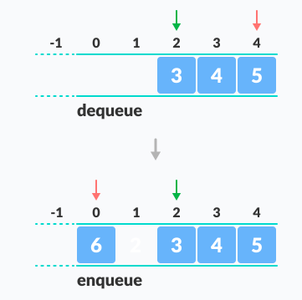
Circular Queues / Buffer
Joseph Marvin R. Imperial
DATA STRUCTURES AND ALGORITHMS
NU College of Computing and Information Technologies
Course Code: CCDATRCL

Slide 18
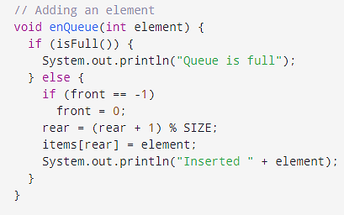
Inserting in a circular queue
Joseph Marvin R. Imperial
DATA STRUCTURES AND ALGORITHMS
NU College of Computing and Information Technologies
Course Code: CCDATRCL

Slide 19
Restricted access
The interface of these structures is designed to enforce this restricted access. Access to other items is (in theory) not allowed.
Queues allow only one item can be inserted or removed at a given time, unless you cheat.
Joseph Marvin R. Imperial
DATA STRUCTURES AND ALGORITHMS
NU College of Computing and Information Technologies
Course Code: CCDATRCL

Slide 20
Applications of queues
Serving requests on a single shared resource, like a printer, CPU task scheduling etc.
Call Center phone systems uses Queues to hold people calling them in an order, until a service representative is free.
Handling of interrupts in real-time systems. The interrupts are handled in the same order as they arrive i.e First come first served.
Joseph Marvin R. Imperial
DATA STRUCTURES AND ALGORITHMS
NU College of Computing and Information Technologies
Course Code: CCDATRCL

Slide 21
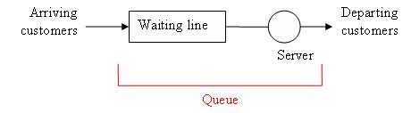
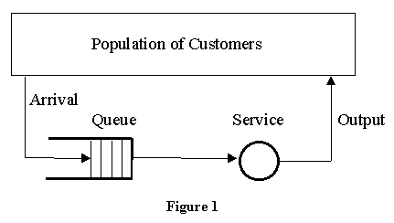
Joseph Marvin R. Imperial
DATA STRUCTURES AND ALGORITHMS
NU College of Computing and Information Technologies
Course Code: CCDATRCL

Slide 22
References
Brilliant - https://brilliant.org/wiki/abstract-data-types/
Queue - https://en.wikipedia.org/wiki/Queue_(abstract_data_type)
Queue 2 - https://www.studytonight.com/data-structures/queue-data-structure
Joseph Marvin R. Imperial
DATA STRUCTURES AND ALGORITHMS
NU College of Computing and Information Technologies
Course Code: CCDATRCL

